Slide 1
Growth and the Environment
Productivity
The Environmental Kuznets Curve
International trade
Over time
Policy implications
Within countries
Environmental justice

Slide 2
0 Introduction
1 Social choice
2 Externalities and public goods
3 Decision analysis
4 Valuation: Aims and purpose
5 Valuation: Revealed preferences
6 Valuation: Stated preferences
7 Direct regulation
8 Market-based instruments
9 Complications with instruments
10 Growth and the environment
11 Green accounting

Slide 3
Growth and the Environment
Productivity
The Environmental Kuznets Curve
International trade
Over time
Policy implications
Within countries
Environmental justice

Slide 4
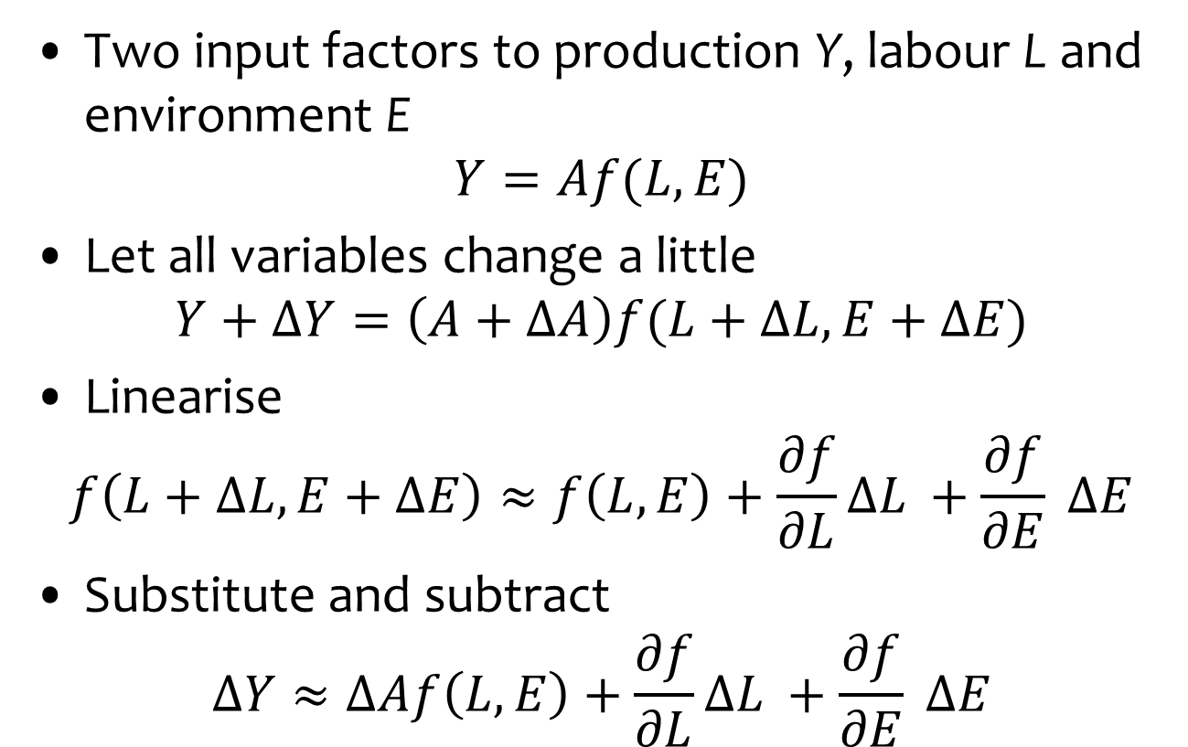
Measuring Productivity Growth
Two input factors to production Y, labour L and environment E
$$Y=Af(L,E)$$
Let all variables change a little
$$Y+ΔY=\left(A+ΔA\right)f(L+ΔL,E+ΔE)$$
Linearise
$$f\left(L+ΔL,E+ΔE\right)≈f\left(L,E\right)+\frac{∂f}{∂L}ΔL +\frac{∂f}{∂E} ΔE$$
Substitute and subtract
$$ΔY≈ΔAf\left(L,E\right)+\frac{∂f}{∂L}ΔL +\frac{∂f}{∂E} ΔE$$

Slide 5

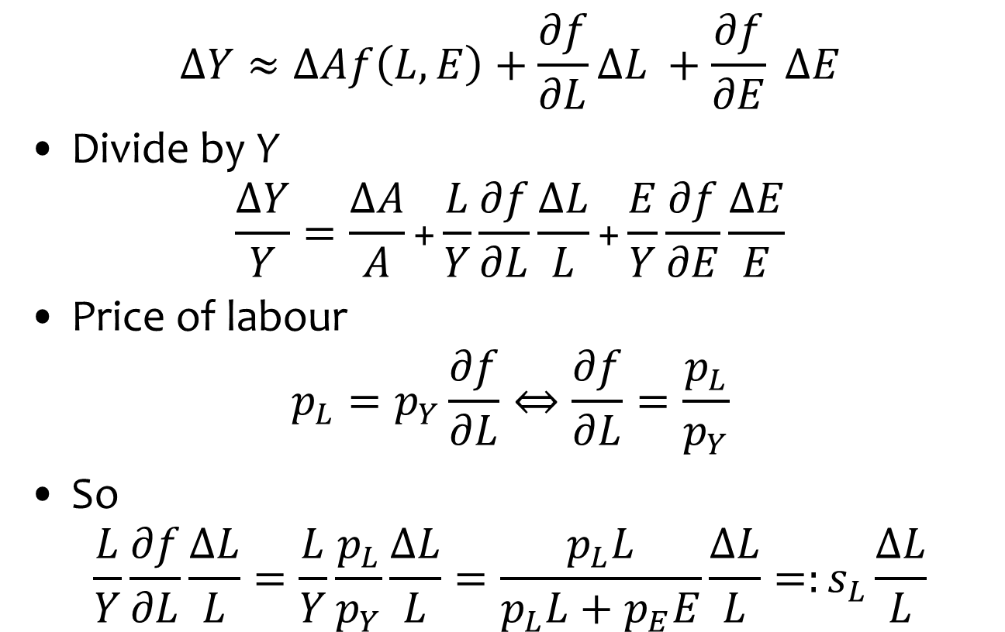
Measuring Productivity Growth
$$ΔY≈ΔAf\left(L,E\right)+\frac{∂f}{∂L}ΔL +\frac{∂f}{∂E} ΔE$$
Divide by Y
$$\frac{ΔY}{Y}=\frac{ΔA}{A}\text{+}\frac{L}{Y}\frac{∂f}{∂L}\frac{ΔL}{L}\text{+}\frac{E}{Y}\frac{∂f}{∂E}\frac{ΔE}{E}$$
Price of labour
$$p_{L}=p_{Y}\frac{∂f}{∂L}⇔\frac{∂f}{∂L}=\frac{p_{L}}{p_{Y}}$$
So
$$\frac{L}{Y}\frac{∂f}{∂L}\frac{ΔL}{L}=\frac{L}{Y}\frac{p_{L}}{p_{Y}}\frac{ΔL}{L}=\frac{p_{L}L}{p_{L}L+p_{E}E}\frac{ΔL}{L}=:s_{L}\frac{ΔL}{L}$$
$$Y=Af(L,E)$$

Slide 6
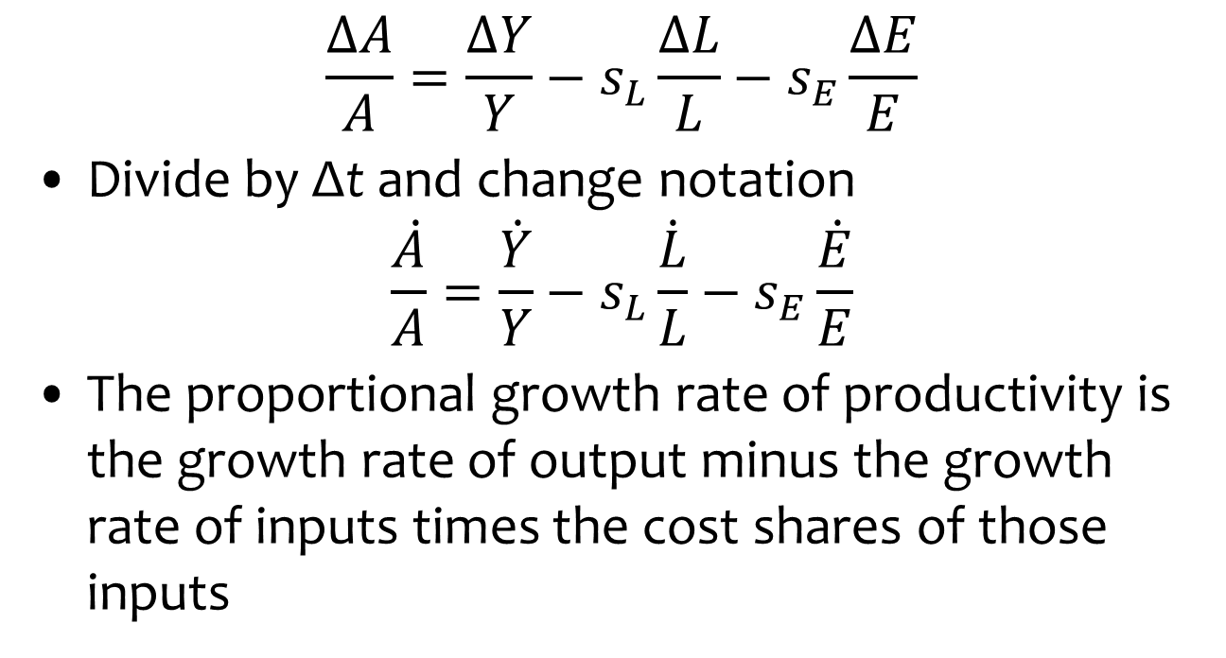
Measuring Productivity Growth
$$\frac{ΔA}{A}=\frac{ΔY}{Y}−s_{L}\frac{ΔL}{L}−s_{E}\frac{ΔE}{E}$$
Divide by Δt and change notation
$$\frac{\dot{A}}{A}=\frac{\dot{Y}}{Y}−s_{L}\frac{\dot{L}}{L}−s_{E}\frac{\dot{E}}{E}$$
The proportional growth rate of productivity is the growth rate of output minus the growth rate of inputs times the cost shares of those inputs

Slide 7
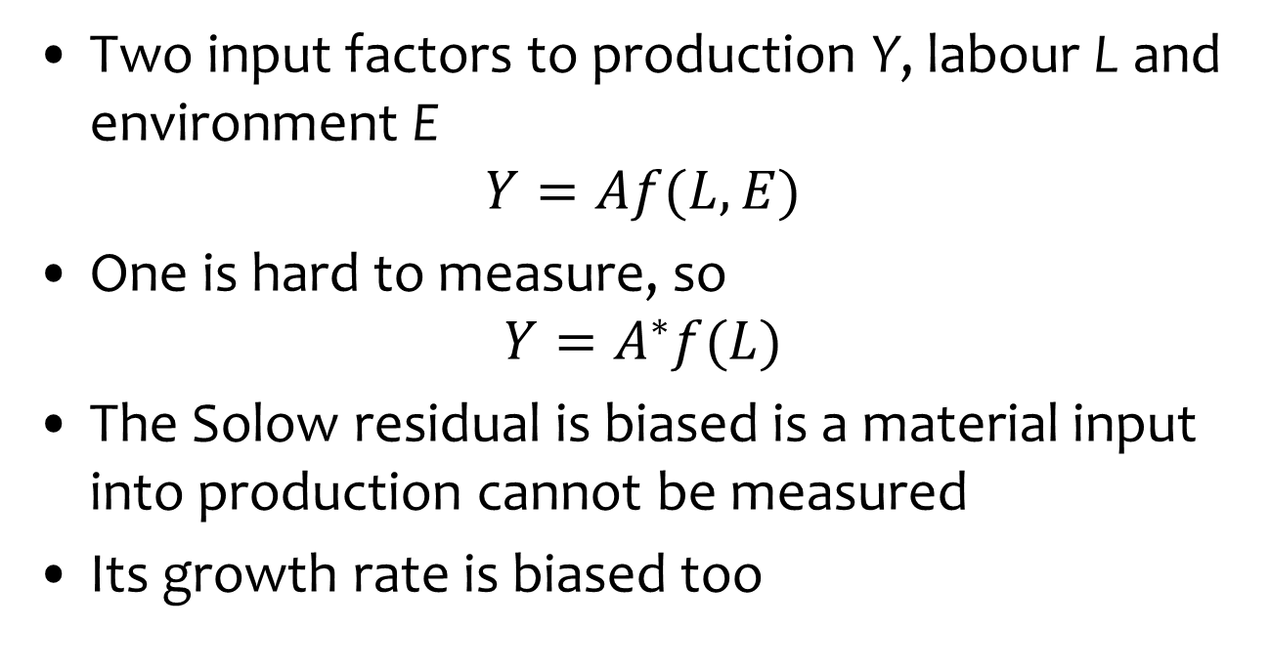
Mismeasuring Productivity
Two input factors to production Y, labour L and environment E
$$Y=Af(L,E)$$
One is hard to measure, so
$$Y=A^{∗}f(L)$$
The Solow residual is biased is a material input into production cannot be measured
Its growth rate is biased too

Slide 8
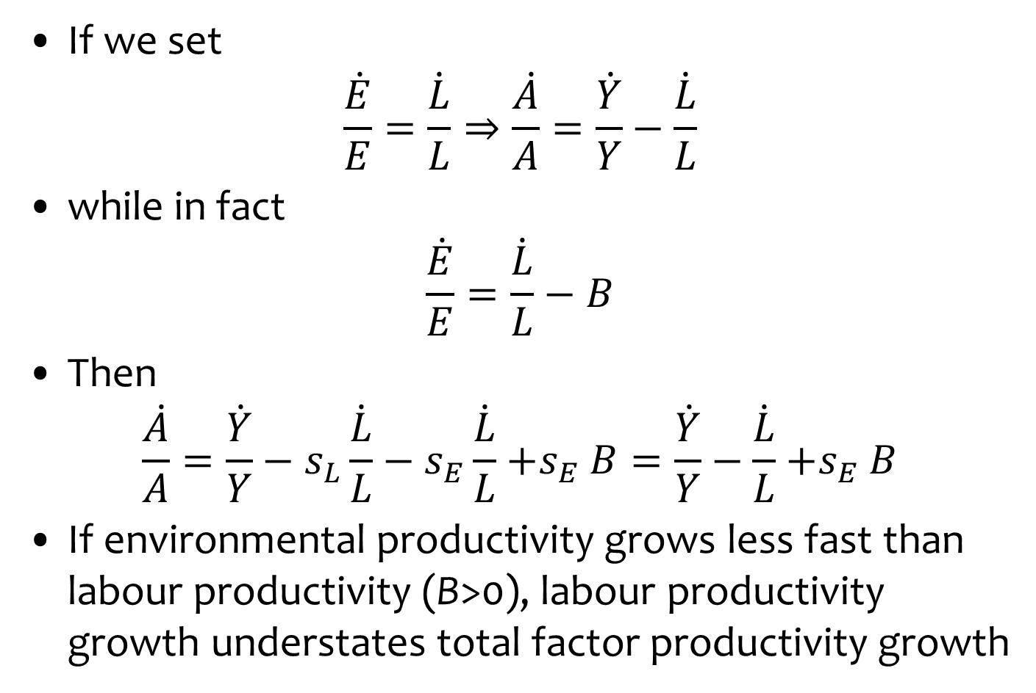
Mismeasuring Productivity Growth
If we set
$$\frac{\dot{E}}{E}=\frac{\dot{L}}{L}⇒\frac{\dot{A}}{A}=\frac{\dot{Y}}{Y}−\frac{\dot{L}}{L}$$
while in fact
$$\frac{\dot{E}}{E}=\frac{\dot{L}}{L}−B$$
Then
$$\frac{\dot{A}}{A}=\frac{\dot{Y}}{Y}−s_{L}\frac{\dot{L}}{L}−s_{E}\frac{\dot{L}}{L}{+s}_{E}B=\frac{\dot{Y}}{Y}−\frac{\dot{L}}{L}{+s}_{E}B$$
If environmental productivity grows less fast than labour productivity (B>0), labour productivity growth understates total factor productivity growth

Slide 9
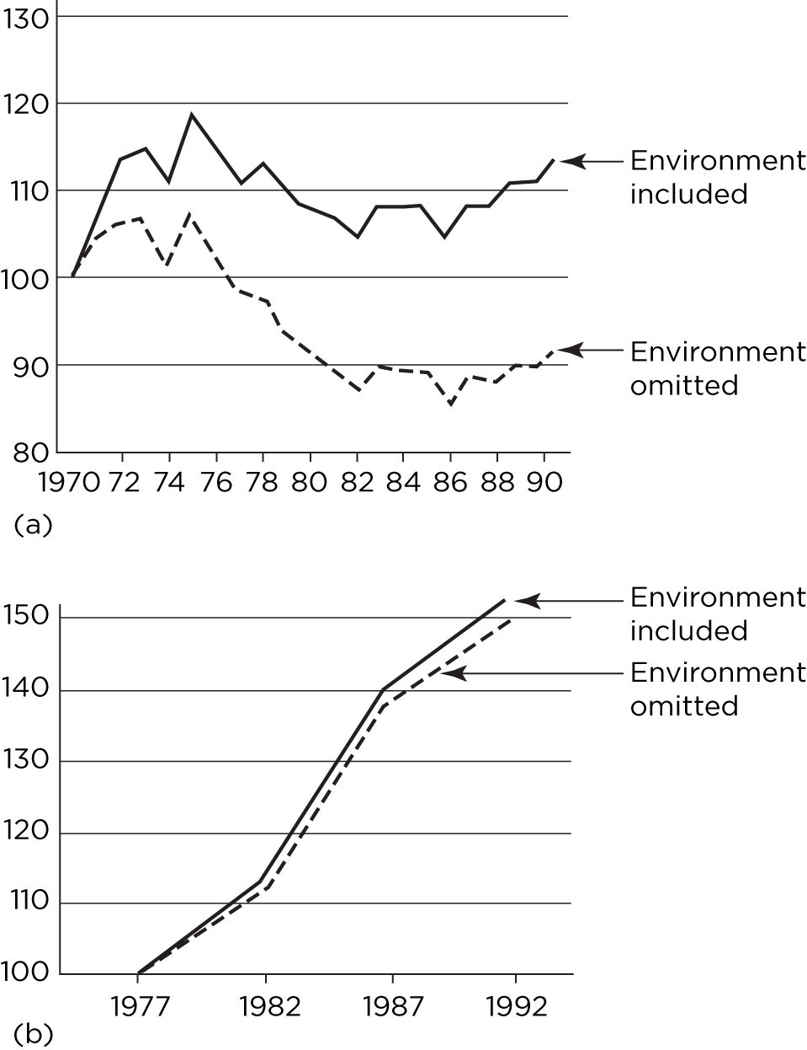

Total factor productivity
growth, with and without
environment, by sector
(top: electricity, bottom:
agriculture), USA
Growth is faster if
environment included.

Slide 10
Growth and the Environment
Productivity
The Environmental Kuznets Curve
International trade
Over time
Policy implications
Within countries
Environmental justice

Slide 11
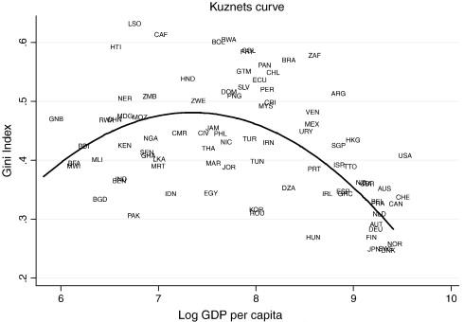
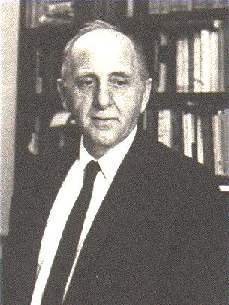
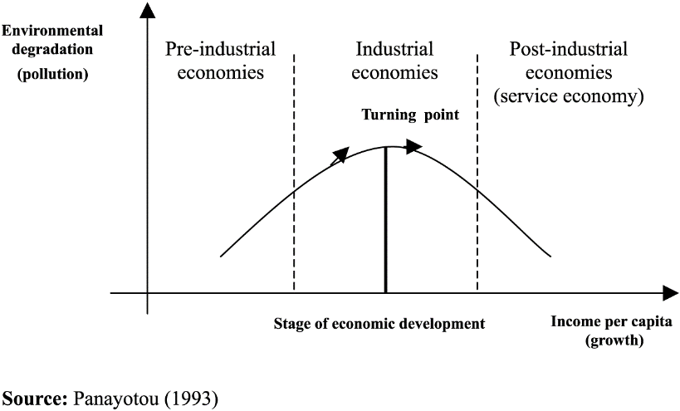

Slide 12




Slide 13
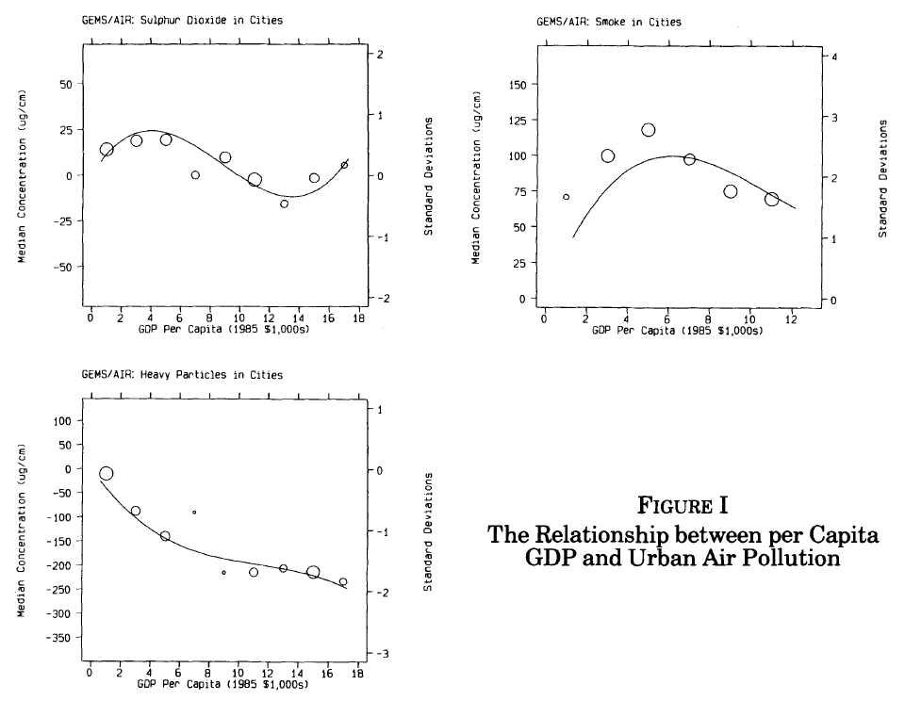

Slide 14
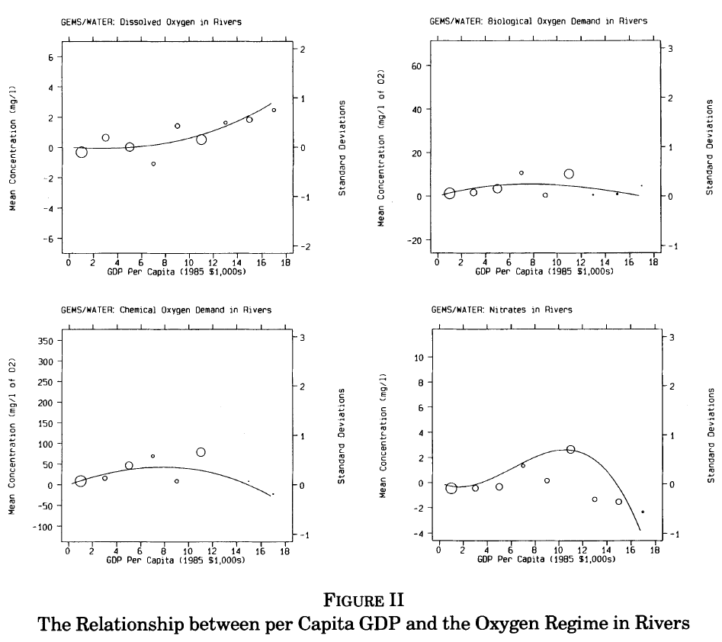

Slide 15
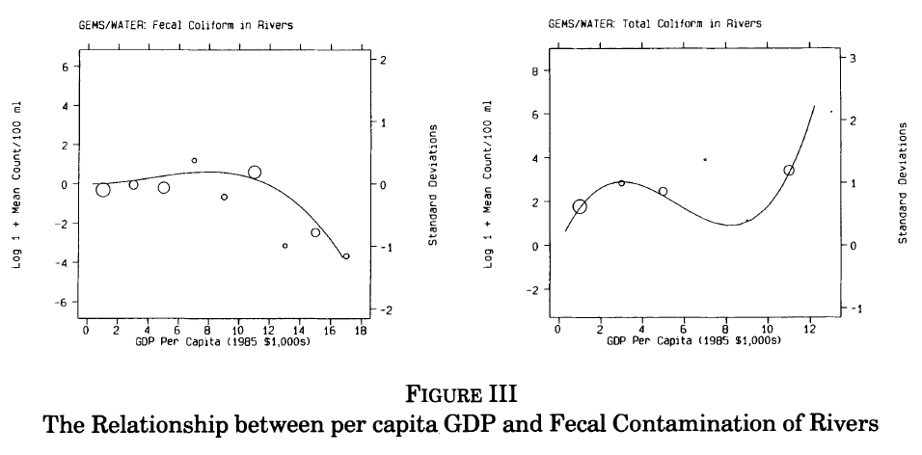

Slide 16
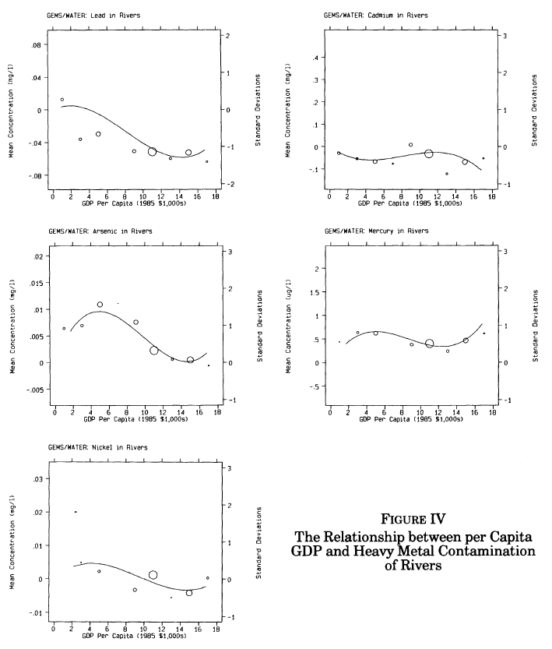

Slide 17
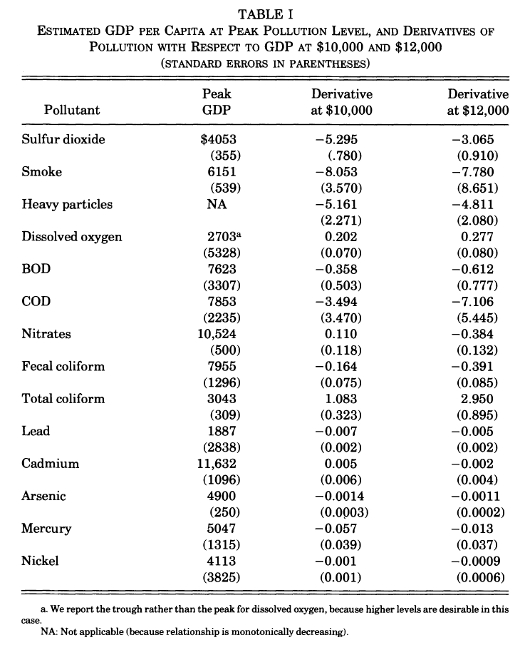

Slide 18

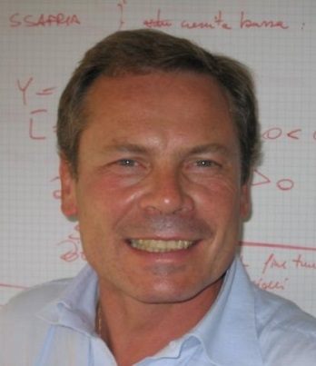
Environmental Kuznets Curve
The Grossman-Krueger (1991, 1995) papers spawned a large literature
Indicators of environmental quality
Countries, sectors
Time periods
Specifications
Estimators
Stern “the rise and fall of the EKC”
Galeotti “desperately seeking the EKC”

Slide 19
Growth and the Environment
Ambiguous results unsurprising
Economic growth has a number of effects
Scale – more, more, more
Composition – agriculture, manufacturing, services
Technology – improved efficiency, new things
Demand – for a cleaner environment
Governance – improved delivery, but longer deliberation

Slide 20
Environmental Kuznets Curve -2
Local pollutants harmful to human health indeed tend to rise then fall with economic development, but the turning point is different for different contaminants, countries, periods
For global issues, no Environmental Kuznets Curve in sight – or at least not for totals

Slide 21
Growth and the Environment
Productivity
The Environmental Kuznets Curve
International trade
Over time
Policy implications
Within countries
Environmental justice

Slide 22
Growth and the Environment
Ambiguous results unsurprising
Economic growth has a number of effects
Scale – more, more, more
Composition – agriculture, manufacturing, services
Technology – improved efficiency, new things
Demand – for a cleaner environment
Governance – improved delivery, but longer deliberation
This assumes a closed economy
International trade complicates things further

Slide 23
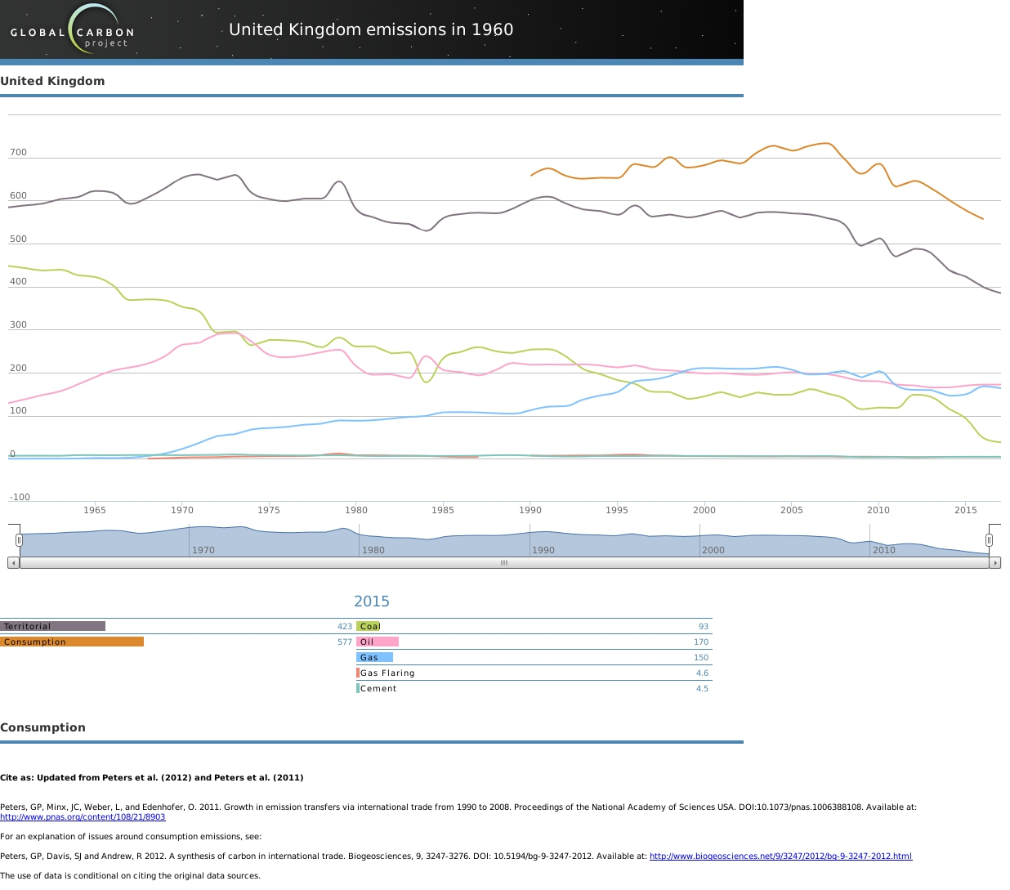

Slide 24
Trade affects
production &
consumption
and so
emissions &
environmental
Kuznets curve.

Slide 25
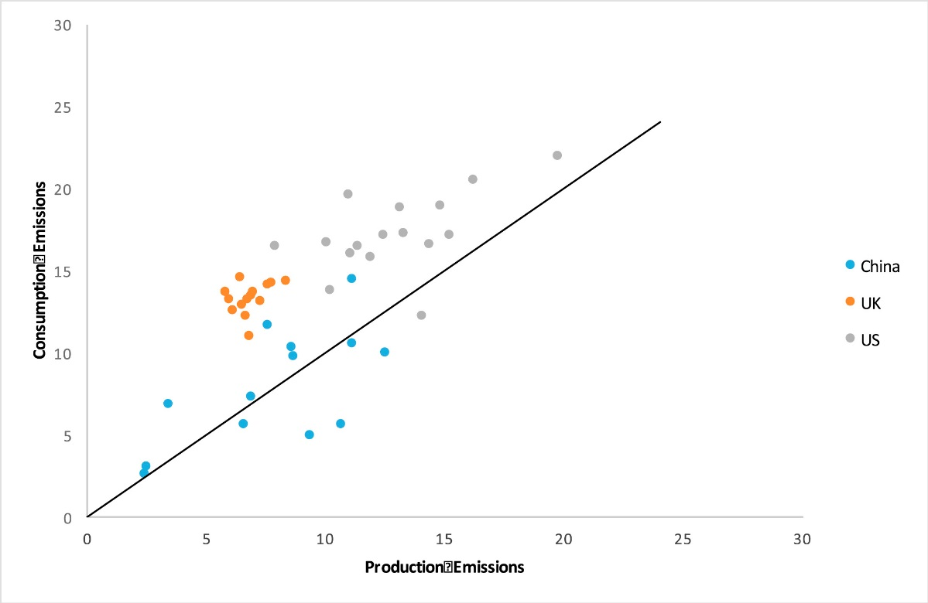
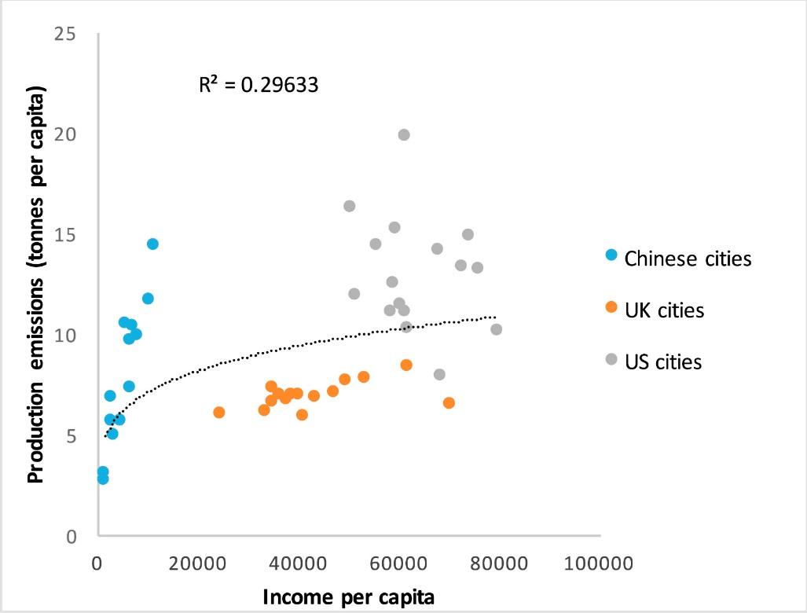
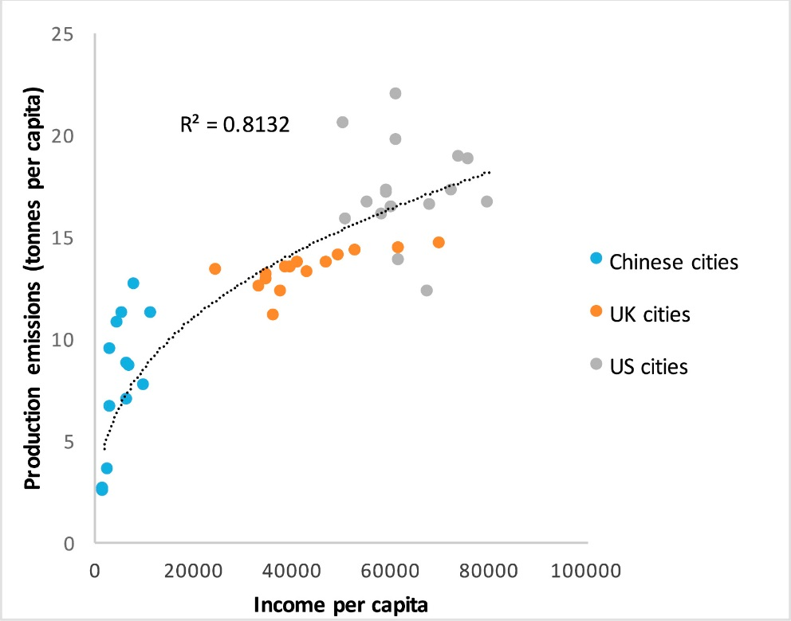
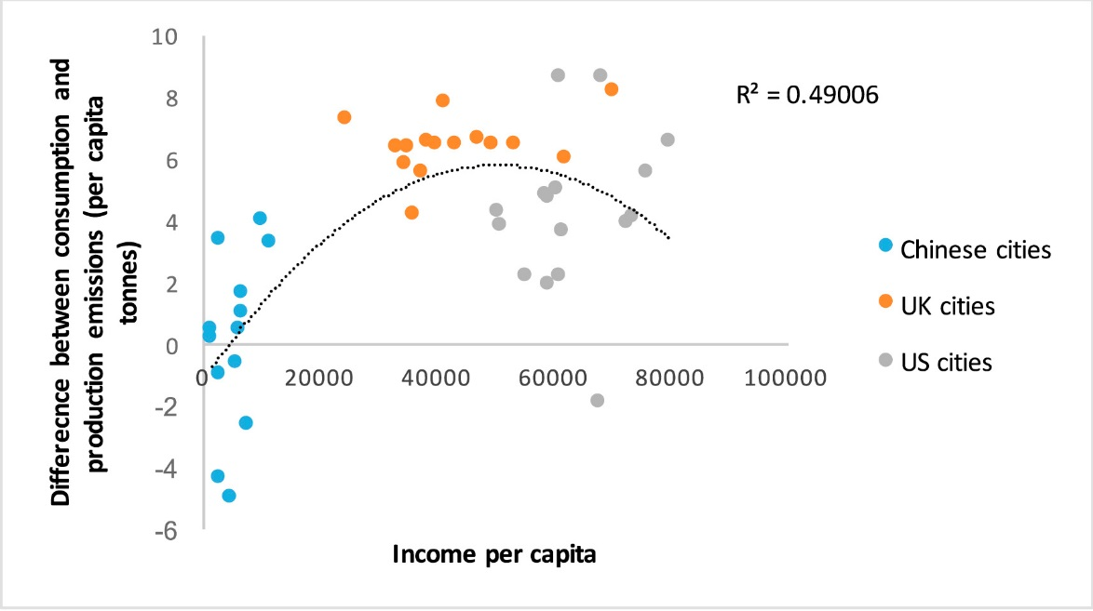
Consumption

Slide 26
International Trade
International trade further complicates the analysis of the Environmental Kuznets Curve
It is easy, indeed tempting, to mistake offshoring of production and hence pollution for a clean-up
Trends in exporting, assembling, and transit countries need similar care in their interpretation

Slide 27
Growth and the Environment
Productivity
The Environmental Kuznets Curve
International trade
Over time
Policy implications
Within countries
Environmental justice

Slide 28
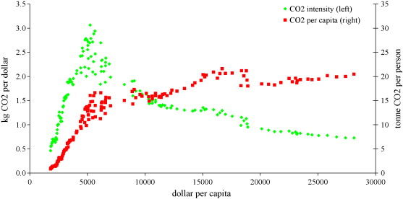
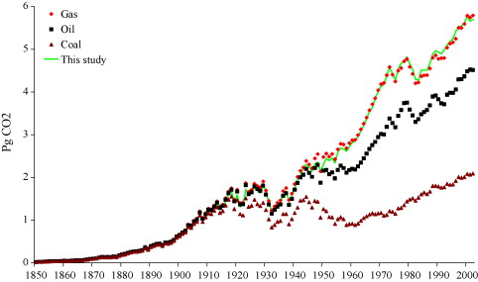

Slide 29
Policy Implications
The Environmental Kuznets Curve suggests a policy implication: Grow rich and all will be fine
However, the EKC is an association, no suggestion of a causal relationship
Let’s look at cycling

Slide 30
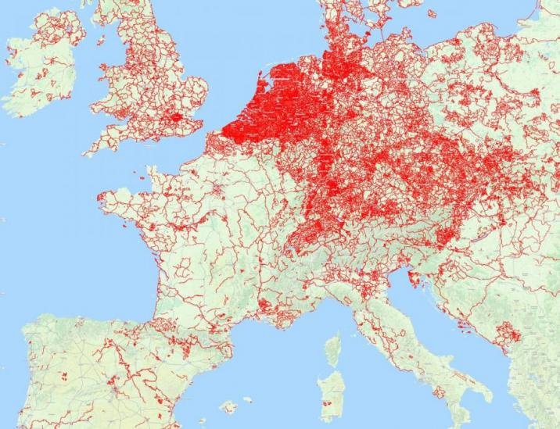
Cycle paths

Slide 31
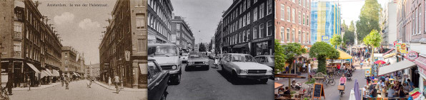
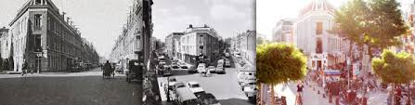

Slide 32
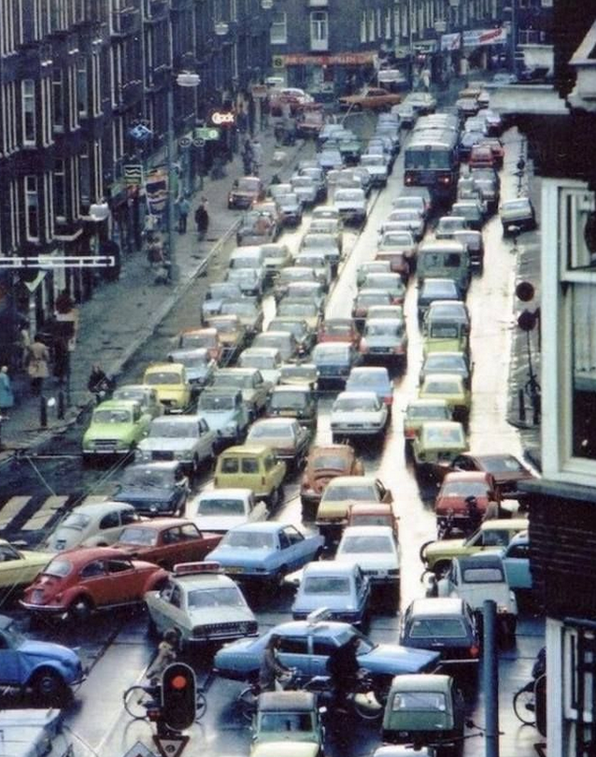

Slide 33
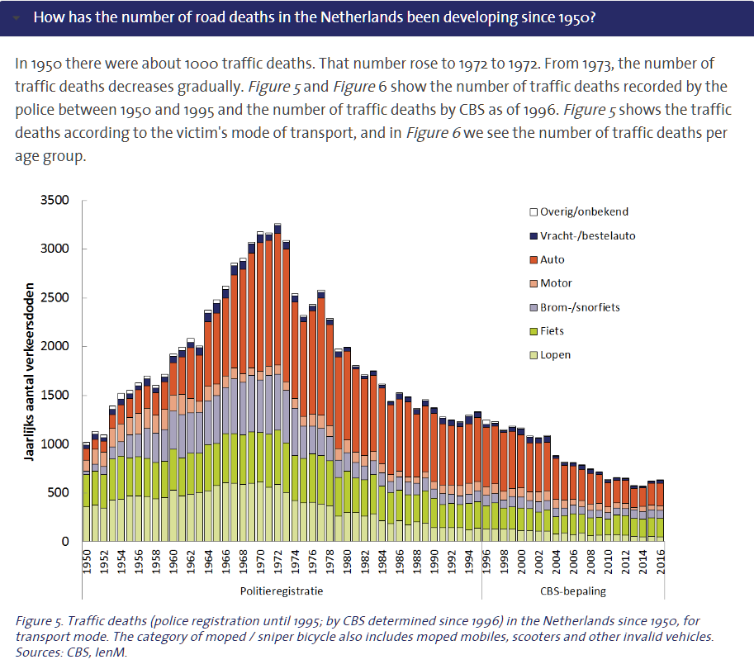

Slide 34
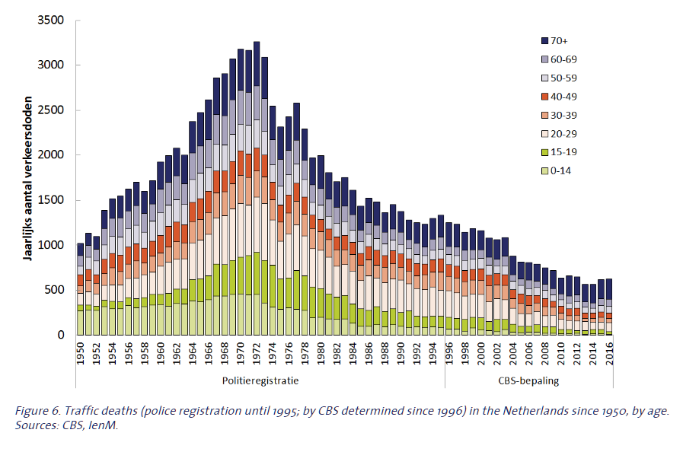

Slide 35


Slide 36
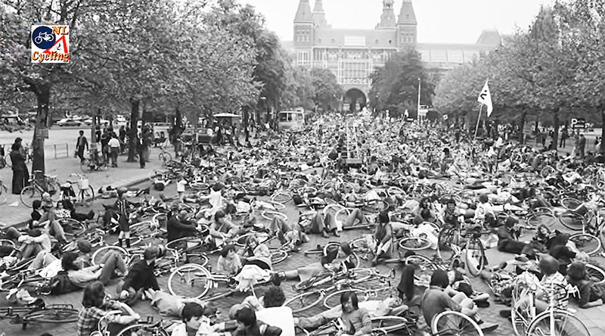
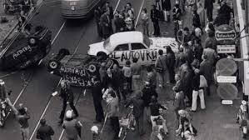
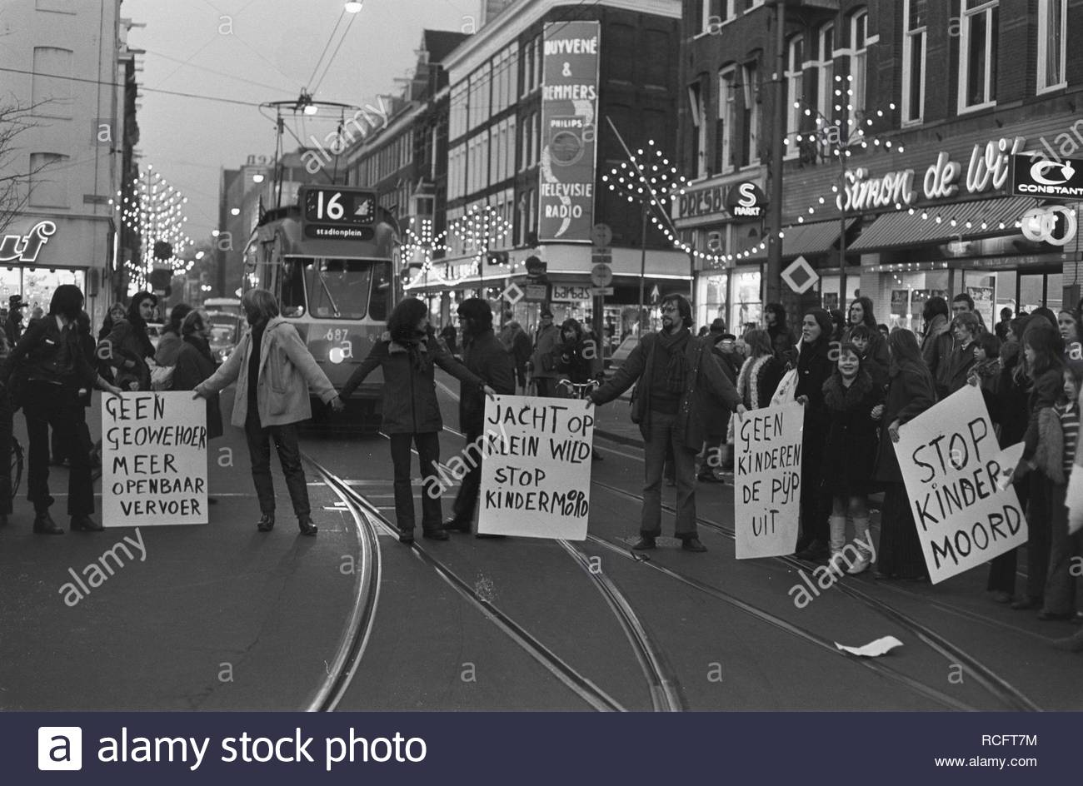

Slide 37
Policy Implications
The Environmental Kuznets Curve suggests a policy implication: Grow rich and all will be fine
However, the EKC is an association, no suggestion of a causal relationship
Environmental clean-up requires policy intervention

Slide 38
Growth and the Environment
Productivity
The Environmental Kuznets Curve
International trade
Over time
Policy implications
Within countries
Environmental justice
Incidence of environmental problems and policy

Slide 39

Poorer people drive older cars,
richer people drive more with heavier cars.

Slide 40
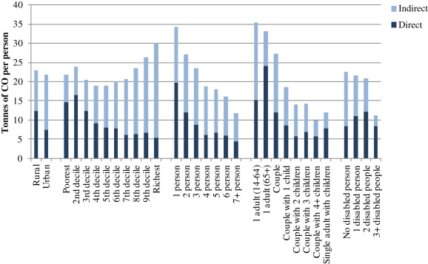
Environmental Justice
Pressure on the environment is different for different socio-economic groups

Slide 41
Environmental Justice
Pressure on the environment is different for different socio-economic groups
Concerns about environmental justice do not stop there

Slide 42
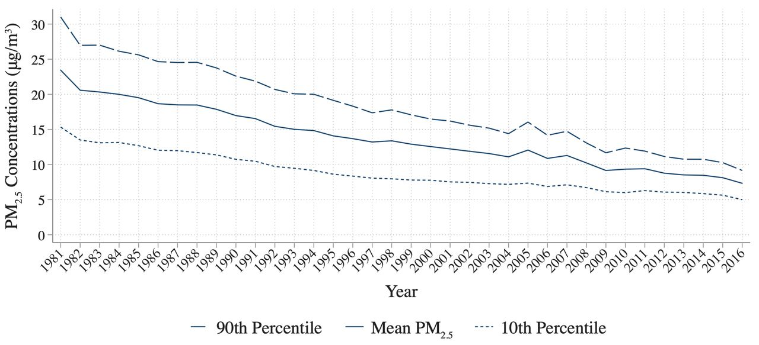
Jonathan Colmer et al. Science 2020;369:575-578

Slide 43
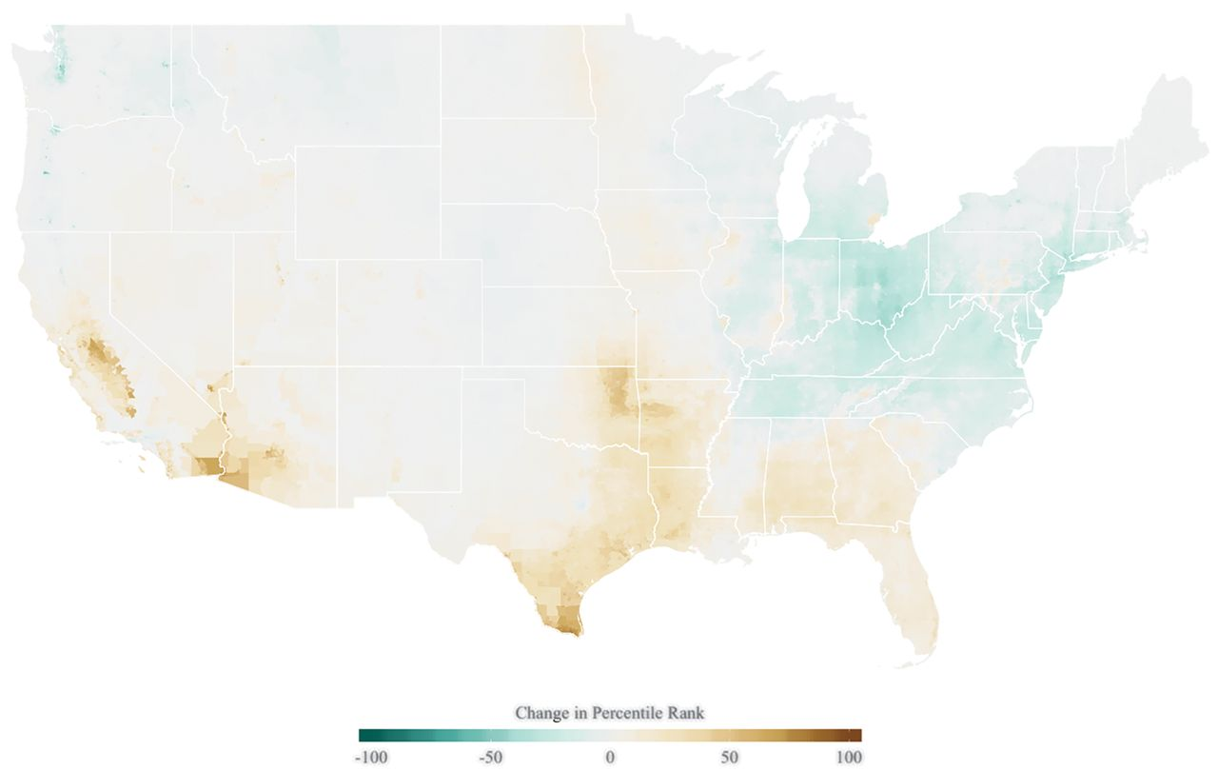
Jonathan Colmer et al. Science 2020;369:575-578

Slide 45
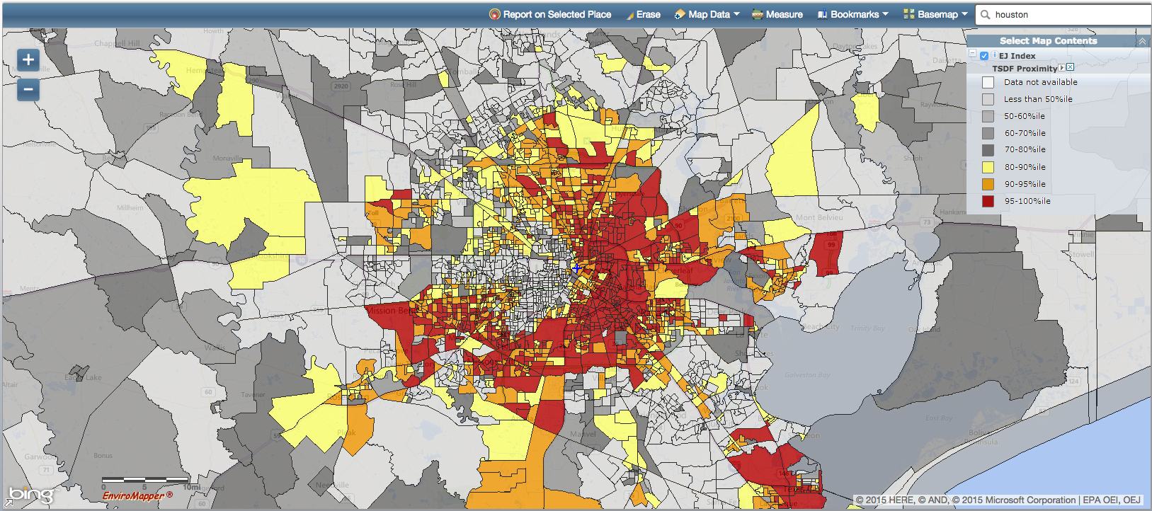
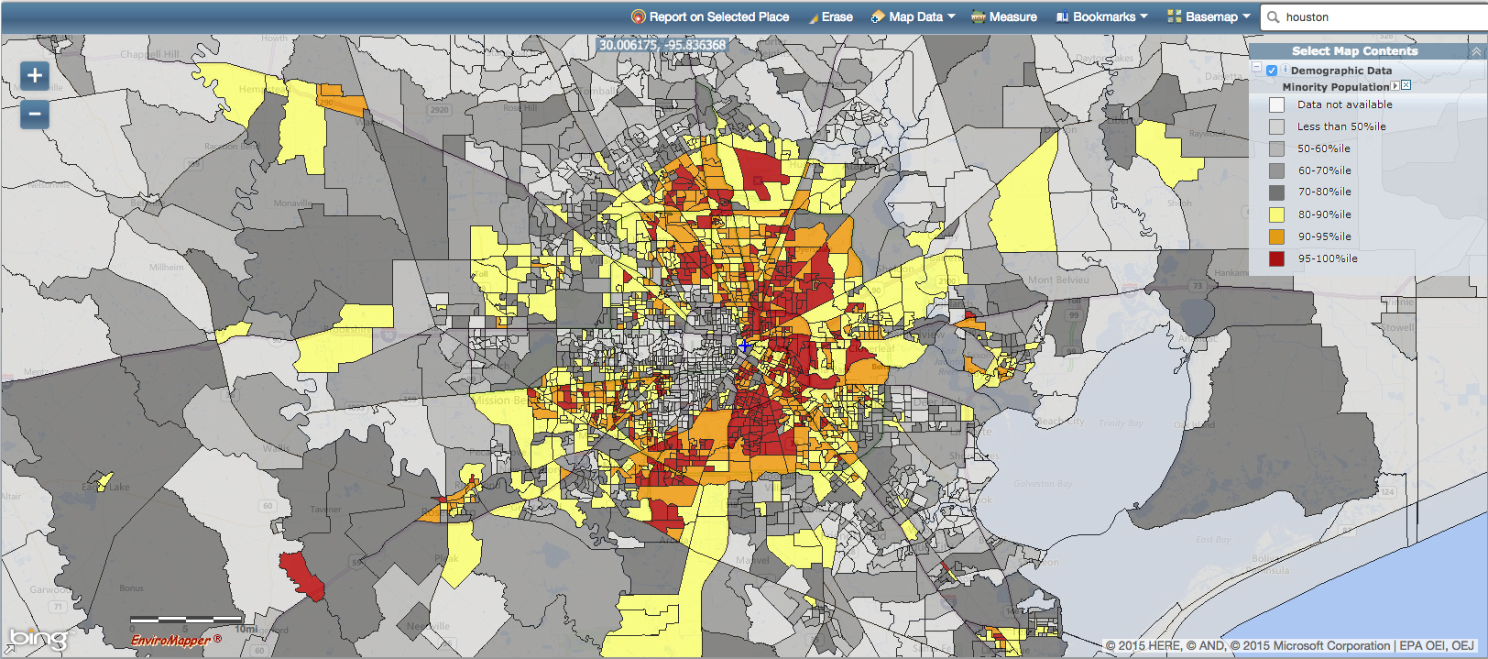
Houston
waste
minorities

Slide 46
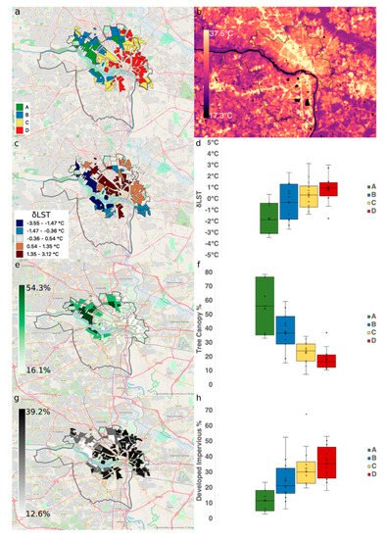
Richmond
1930s redlining
temperature
temperature
by polygon
tree cover
impervious
surface
Hoffmann et al. Climate 2020, 8(1), 12

Slide 47
Environmental Justice
Pressure on the environment is different for different socio-economic groups
Environmental hazards tend to be sited near the poor and deprived
House prices are lower near environmental hazards, attracting the poor and deprived

Slide 48
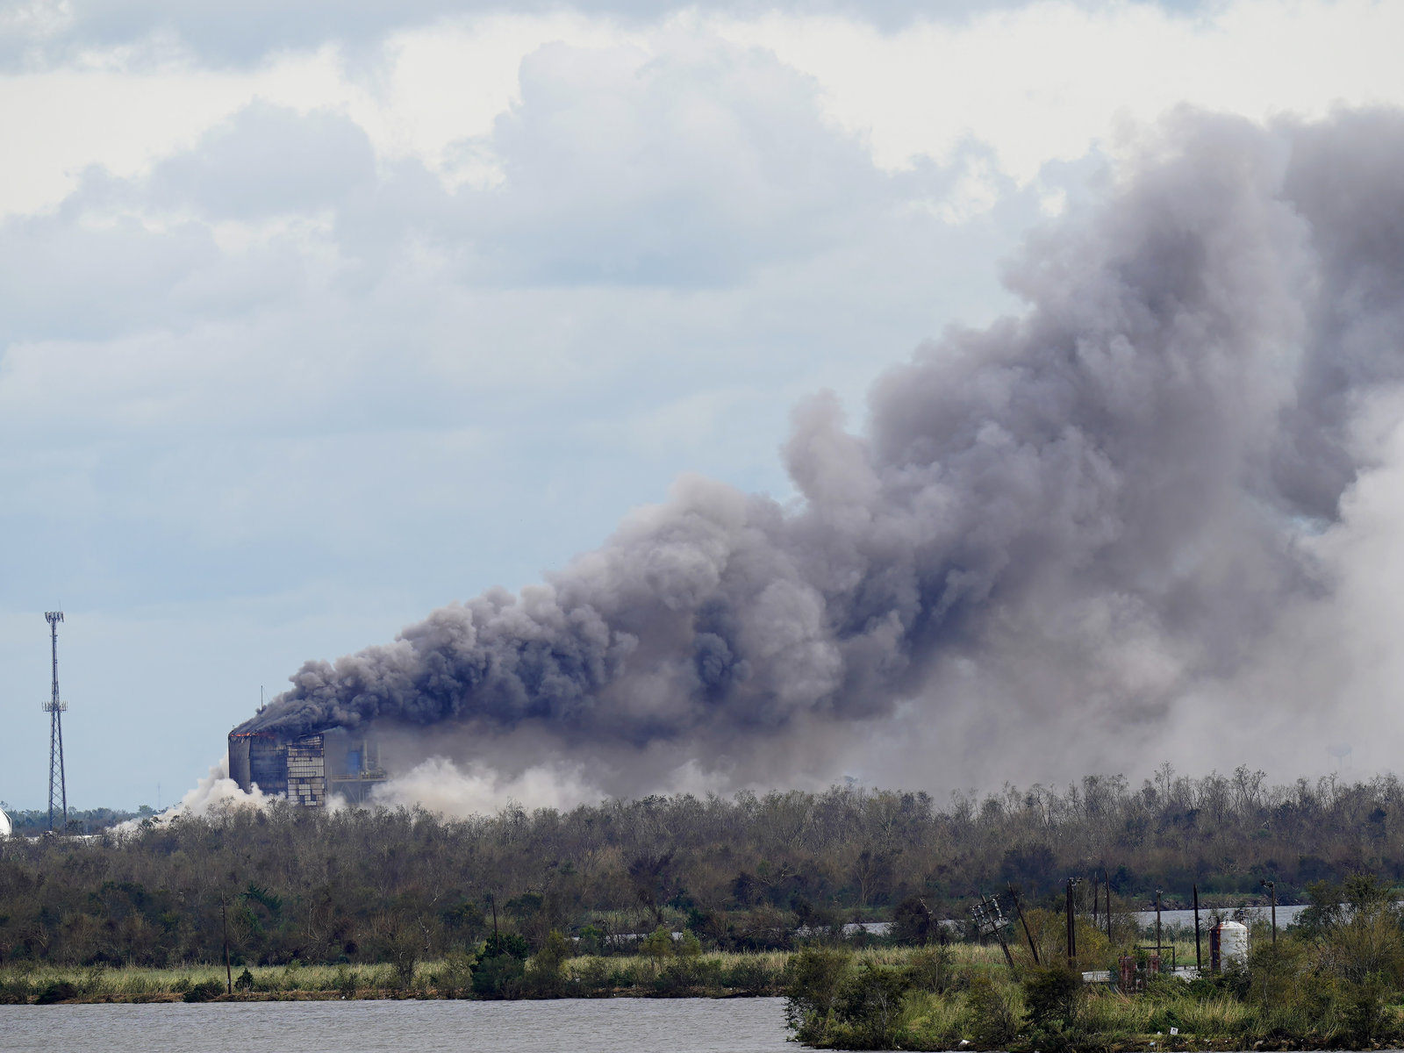
A chemical plant caught fire after Hurricane Laura

Slide 49
“We have sacrifice zones across the Gulf Coast. They are communities of color and lower wealth communities that are often pushed into our most dangerous locations through redlining, through restrictive covenants [and] through zoning practices.”
Mustafa Ali, former EPA

Slide 50
Environmental Justice
Pressure on the environment is different for different socio-economic groups
Incidence of environmental policy is therefore different for different groups

Slide 51
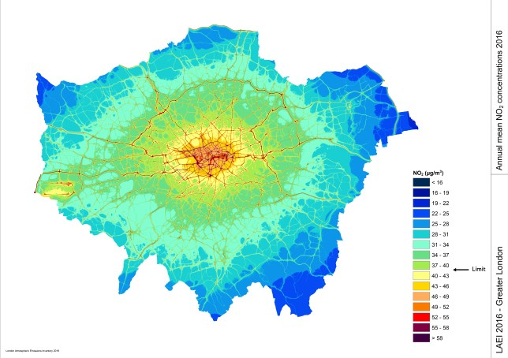

Slide 53

London air pollution
particularly hits the poor,
so congestion charges
primarily benefitted the
poor.

